Slide 1




Indian LokSabha Elections 2024 Analysis
Github Link

Slide 2

PROJECT OVERVIEW
Leveraged SQL to explore and analyze 2024 Indian General Election data
Uncovered trends in party performance and alliance dominance across states
Applied various SQL concepts including JOINS, CASE WHEN & aggregations.
Designed a Power BI dashboard for clear, interactive storytelling
Demonstrates skills in data modeling, SQL analytics, and data visualization

Slide 3
PROBLEM STATEMENT
Total Seats
Total number of seats available for elections in each state
Total seats won by NDA Alliance
Seats won by NDA Alliance parties
Total seats won by I.N.D.I.A Alliance
Seats Won by I.N.D.I.A. Alliance Parties
Add new column field in table partywise_results to get the Party Alliance as NDA, I.N.D.I.A and OTHER
Update values of Party Alliance column
Which Party Alliance won the most seats across all seats
SWOT stands for Strengths, Weaknesses, Opportunities, and Threats. It's a framework that allows you to assess your current situation, identify key factors impacting your project, and develop strategic plans to maximize your chances of success.

Slide 4
PROBLEM STATEMENT
Winning candidate's name, their party name, total votes, and the margin of victory for a specific state and constituency?
What is the distribution of EVM votes versus postal votes for candidates in a specific constituency?
Which parties won the most seats in each State, and how many seats did each party win?
What is the total number of seats won by each party alliance (NDA, I.N.D.I.A, and OTHER) in each state for the Indian Elections 2024
Which candidate received the highest number of EVM votes in each constituency (Top 10)?
Which candidate won and which candidate was the runner-up in each constituency of State for the 2024 elections?
SWOT stands for Strengths, Weaknesses, Opportunities, and Threats. It's a framework that allows you to assess your current situation, identify key factors impacting your project, and develop strategic plans to maximize your chances of success.

Slide 5


Data Sources
constituencywise_details: This Excel file contains candidate-level data for each constituency, including their party affiliation, vote counts (EVM and postal), total votes received, vote percentage, and the corresponding constituency ID.
constituency_results: This Excel file summarizes the election outcome for each parliamentary constituency, showing the winning candidate, total votes polled, victory margin, and links to party and constituency identifiers.
partywise_results: This Excel file shows the total number of seats won by each political party, along with their unique party ID.

Slide 6
Data Sources
statewise_results: This Excel file provides detailed election results at the state level, listing each constituency along with its number, leading and trailing candidates, victory margin, and election status. It also includes the associated state name and state ID, enabling geographic analysis of results.
States: This Excel file maps each state ID to its corresponding state name for reference and relational linking in the dataset.

Slide 7
Indian LokSabha Elections 2024 Analysis
ENTITY RELATIONSHIP DIAGRAM (ERD)/ SCHEMA
states
State
State ID
partywise_results
Party
Won
Party ID (PK)
State ID
Party ID
statewise_results
Parliament Constituency
Constituency
Constituency No.
Leading Candidates
Trailing Candidates
Margin
Status
State
State ID
Constituencywise_details
Candidate
Party
EVM Votes
Postal Votes
Total Votes
% of Votes
Constituency ID (FK)
Constituencywise_results
Parliament Constituency
Constituency Name
Winning Candidates
Total Votes
Margin
Constituency ID (PK)
Party ID (FK)
Constituency
ID
Parliament Constituency

Slide 8
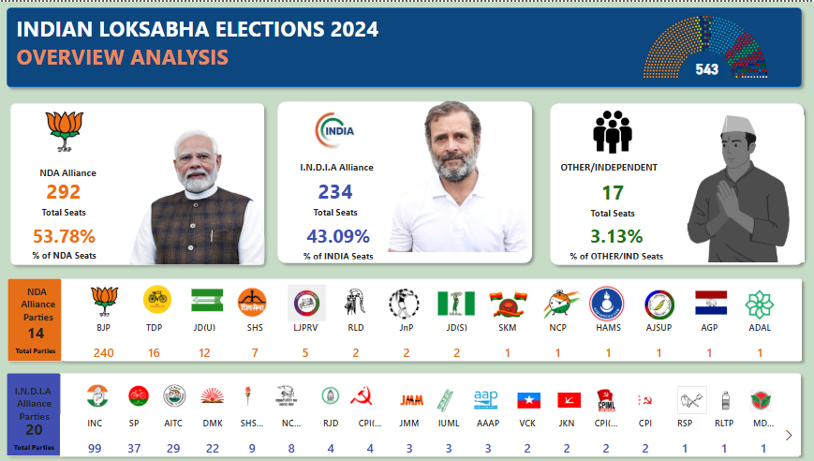
Snapshot of PowerBI Dashboard

